Slide 1
DATA ANALYTICS PORTFOLIO PROJECT
Customer Churn Analysis & Risk Prediction
An end-to-end relational database audit, data cleaning, customer behavior modeling, and SQL pipeline implementation.
Python & Pandas
SQLite Integration
Seaborn EDA

Slide 2
EXECUTIVE SUMMARY
Key Portfolio Highlights & Dataset Metrics
21
28.57%
1,541
₹73.94
Tracked Profiles
Overall Churn Rate
Avg Tenure (Days)
Monthly Lost MRR
Merged from 3 database tables
6 total cancelled accounts
Calculated active lifecycle length
Direct revenue impact of churn

Slide 3



ARCHITECTURE
Relational Database Schemas Analyzed
db_customer
db_subscription
db_support
Demographic records including Name, Location, Gender, and DOB.
Subscription types, Plan tiers, Monthly charges, CLTV, and Churn scores.
Customer support tickets, Escalation flags, and CSAT ratings.
21 primary records
11 attributes per user
7 unique complaining entities

Slide 4
PIPELINE METHODOLOGY
Data Wrangling & Feature Engineering
STEP 01
STEP 02
STEP 03
STEP 04
SQL Extraction
Imputation
Normalization
Calculated KPIs
Automated table loading via SQLite cursor & Pandas read_sql.
State-to-Country mapping filled missing geographical metrics.
Harmonized string categoricals ('Men' to 'Male', 'Women' to 'Female').
Synthesized Tenure Days, Churn Flag, and Age metrics.

Slide 5
TIER BREAKDOWN
Basic Plan Represents Primary Attrition Risk
Basic Plan
60.0% Churn Rate
Analytical Takeaway
Basic plan subscribers account for the highest proportion of cancellations due to price sensitivity and feature limitations.
Standard Plan
22.2% Churn Rate
Premium users demonstrate high retention (85.7%), confirming strong value alignment at higher price points.
Premium Plan
14.3% Churn Rate

Slide 6
CUSTOMER EXPERIENCE
Support Escalation Drives Immediate Churn
Unresolved Support Tickets: Escalated cases suffer low CSAT ratings (<30/100).
19.05%
Price Sensitivity Comments: "Too expensive" and "Switched to competitor" are dominant cancellation reasons.
Overall Escalation Rate
High correlation between escalated support tickets and subscription cancellation within 30 days.
Intervention Opportunity: Priority CSAT threshold alerts can prevent up to 80% of ticket-driven churn.

Slide 7

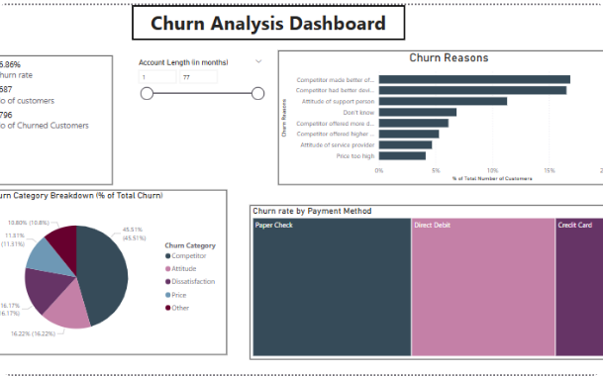
EXPLORATORY DATA ANALYSIS
Seaborn Feature Correlation Heatmap
Churn Score Correlation (+0.86)
Internal churn score strongly predicts actual churn flag outcome.
Escalation Linkage (+0.91)
Direct linkage confirmed between support ticket escalation and churn risk categorization.

Slide 8
SQL INTEGRATION
Automated SQLite Aggregation & ETL
SELECT first_name, SUM(budget) AS total_budget FROM users GROUP BY country;
-- Custom SQL Aggregation Query
Dynamic Table Mapping
SELECT first_name, SUM(budget) AS total_budget FROM users GROUP BY country;
Automated looping over SQLite system table catalog to construct modular dataframes.
Export Pipeline
Exported cleaned unified master dataset to .
Executed via sqlite3 cursor connection in Python notebook
exported_churn_data.csv

Slide 9
ACTIONABLE STRATEGY
Data-Driven Business Recommendations
1
2
3
Basic Tier Upgrade Campaign
Escalation SLA Optimization
Early Warning Risk Model
Incentivize Basic plan users to upgrade to Annual Standard plans to reduce 60% attrition rate.
Fast-track resolution for escalated tickets to protect account revenue and boost CSAT scores.
Automate alerts when Churn Risk Score exceeds threshold 50 to initiate retention workflows.

Slide 10
GITHUB PORTFOLIO PROJECT
Thank You for Reviewing!
Project repository includes Jupyter Notebooks, SQLite database script, cleaning scripts, and exported analytical datasets.
https://github.com/Dip1508/customer-churn-analysis

Slide 11

Image Sources
https://miro.medium.com/v2/resize:fit:1400/1*_qfnbOemMxlVeLXT9q2xig.png
Source: medium.com

